Slide 1
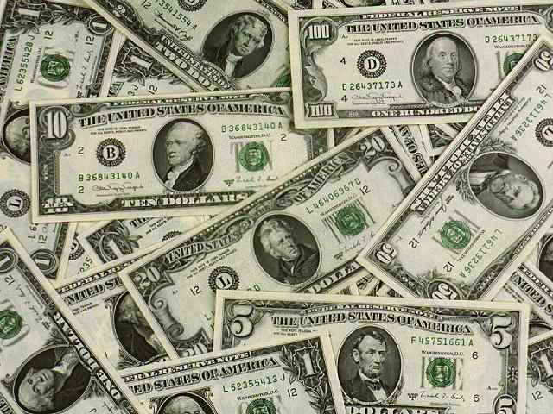
friday, oct.28
You will need your notes and something to write with.
HW: Complete the online activity for 5.05 and take the Practice test. These are both due by Sunday at midnight.

Slide 2

Crash Course - Money

Slide 3

What is money?
Money is any commodity or token that is generally accepted as a means of payment.
  Money is something that can be easily recognized.
  Money can be divided up into small parts.
  Is it generally accepted? – Money can be used to buy anything and everything
  Money is a means of payment – a method of settling a debt.

Slide 4
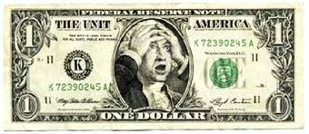
Money Today
Money in the world today is called fiat money – holds no intrinsic value and isn’t backed by any other commodity
So what makes money valuable then? Demand relative to supply
  Fiat money is objects that are money because the law decrees or orders them to be money. In the US, the dollar is considered “legal tender” – meaning it must be accepted as payment for debt or for goods/services
  The objects that we use as money today are
    Currency
    Deposits at banks and other financial institutions

Slide 5
Fiat Money – Explained

Slide 6

What is money?
  Currency in a Bank Is Not Money
  Bank deposits are one form of money, and currency outside the banks is another form.
  Currency inside the banks is not money.
  When you get some cash from the ATM, you convert your bank deposit into currency.

Slide 7


The Functions of Money
Money today provides three vital functions:
Medium of Exchange
Unit of Account
Store of Value

Slide 8

Medium of Exchange
  Medium of exchange is a object that is generally accepted in return for goods and services.
  Without money, you would have to exchange goods and services directly for other goods and services—an exchange called barter.
In order for something to serve as a medium of exchange it must: be scarce relative to other commodities, readily identifiable, durable and divisible, relatively stable supply, and portable.

Slide 9
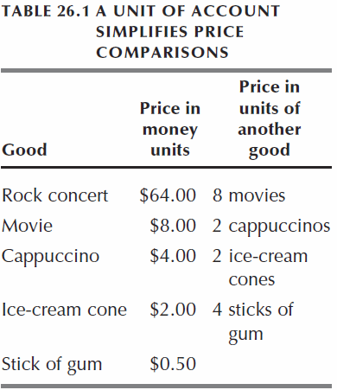
Functions of Money, cont’d.
  Unit of Account
  A unit of account is an agreed-upon measure for stating the prices of goods and services.
  We don’t measure the prices of goods in other goods – money is the unit that we measure prices by.
  This table shows how a unit of account simplifies price comparisons.

Slide 10

Functions of Money, Cont’d.
  Store of Value
  A store of value is any commodity or token that can be held and exchanged later for goods and services.
  The more stable the value of a commodity or token, the better it can act as a store of value and the more useful it is as money.
  Liquidity – meaning something that can be easily converted to cash without loss of value.

Slide 11
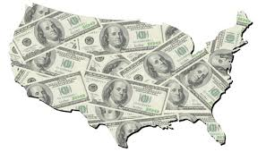
WHAT IS MONEY?
Above all else, money is a medium of exchange.
  M1 (narrowest definition of money) consists of the sum of all currency (coin and paper bills), traveler’s checks, and checkable deposits (Demand Deposits and Other Checkable) owned by individuals and businesses. – This is what is referred to as the Money Supply. It is very liquid.
  M2 (broader definition of money; what most economists prefer) consists of M1 plus savings deposits and small time deposit accounts (>100K), money market funds (interest earning accts offered by banks that pool depositors funds and invest them in highly liquid short-term securities), and other deposits.
  M3 consists of M2 plus large time deposit accounts (<$100k)

Slide 12
WHAT IS MONEY?
  Are M1 and M2 Means of Payment?
  The test of whether something is money is whether it is generally accepted as a means of payment.
  M1 passes this test and is money.
  Some savings deposits in M2 are just as much a means of payment as the checkable deposits in M1.
  Other savings deposits, time deposits, and money market funds are not instantly convertible and are not a means of payment.

Slide 13
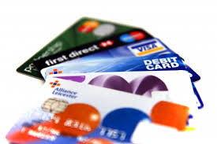
Is it Money?
  Checks? - A check is not money. It is an instruction to a bank to make a payment.
  Credit Card? - A credit card is not money because it does not make a payment. When you use your credit card, you create a debt (the outstanding balance on your card account), which you eventually pay off with money.
  Debit Cards? - It is not money. It is an electronic equivalent of a paper check.
  E-Checks? - An e-check is not money. It is an electronic equivalent of a paper check.

Slide 14

Time Value of Money – Present v Future
Present value is price of what you are going to be paid or what you are going to purchase now. Future value is the value at some point in the future of present amount, i.e. $1,000 two years from now.
Present Value scenario: you win $1 million in the lottery.
Choices: get the whole $1 million in two years, or something smaller right now.
In order to make an informed decision, we would need to know the present v future values.

Slide 15
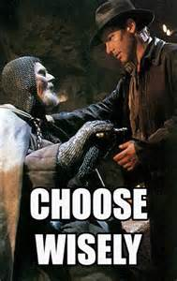
Which do you choose: Now or Later?
It depends on the future value of money. We know the future value: $1 million. However, what is the minimum amount in the present it would take to be paid now.
What is the expected interest rate?
Let’s say that the expected interest rate is 5% and officials are offering you $910,000 now.
Do we take the offer?

Slide 16

Formulas: Fun with Math!
PV = FV x 1/(1 + r)^{n}
PV (Present Value); FV (Future Value); r (Interest rate); n (number of years)
Present Formula
  PV = 1 million x 1/(1 + .05)²
  PV = ?????
Should we take the deal?
Future Formula
  FV = PV x (1 + r)^{n}

Slide 17
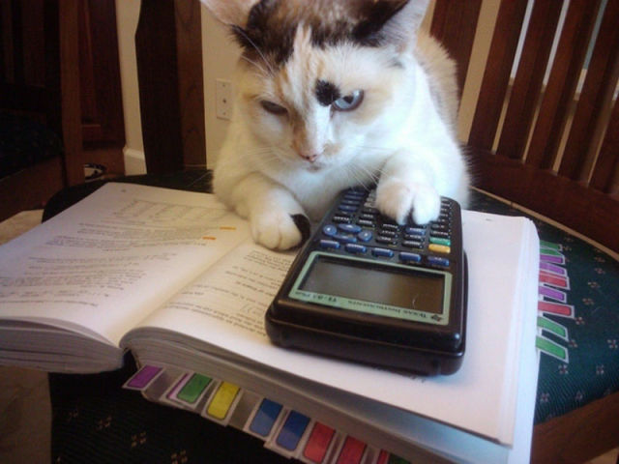
Test Yo’ Knowledge!
Scenario 1: The Federal Reserve issues a $1,000, one year T-Bill (Treasury Bill) paying 5%. The buyer receives the $1,000 at the date of maturity (1 year from now). You pay the present value of the T-Bill upon purchase. What is your purchase price?
Scenario 2: You put $2,000 into a 4 year CD (certificate of deposit) at a rate of 4%. You do not add anymore money. What is the future value?

Slide 18

Whatchu know, peeps?
Scenario 3: You lend someone $120, and he promises to pay you back in 2 years. (“I got you dawg”). You agree to have him pay you back the principal amount, and interest rate of 5%at the end of two years. How much do they pay you in two years?
Scenario 4: You are going to college in 3 years and want to start saving for your books now. Your textbooks for your freshmen year will cost $800. How much money would you need to save NOW if the expected interest rate is 3% to have money for this purchase freshmen year?

Slide 19
Tuesday, oct.2
You will need your notes and something to write with.
HW: Work on Textbook Questions and Online Quizzes

Slide 20
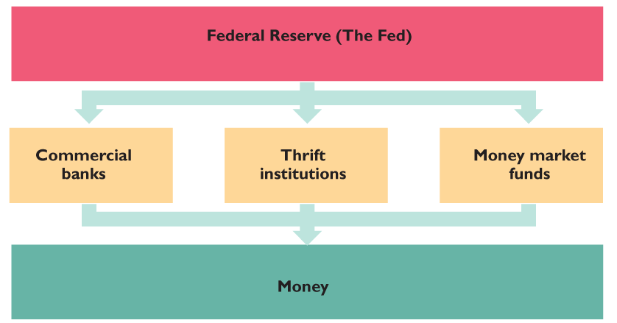
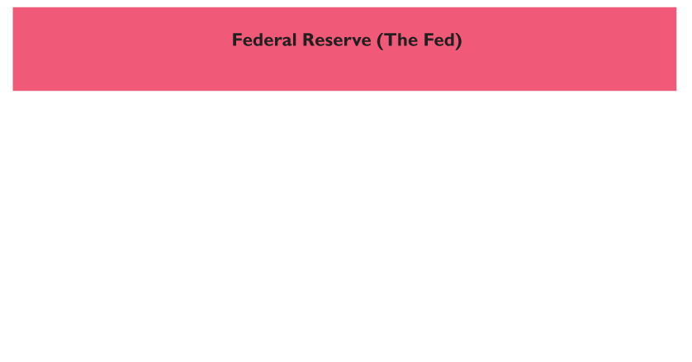
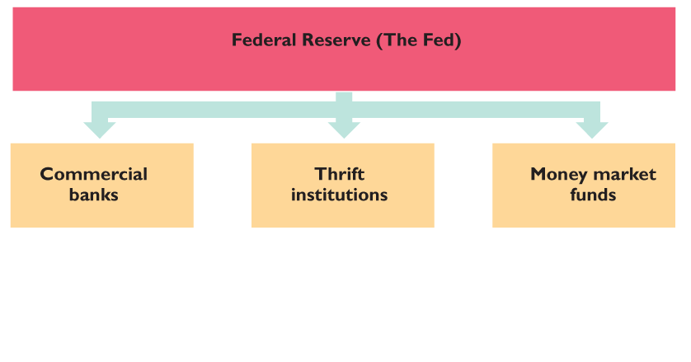
THE BANKING SYSTEM
The figure shows the institutions of the banking system.
The Federal Reserve regulates and influences the activities of the commercial banks, thrift institutions, and money market funds, whose deposits make up the nation’s money.

Slide 21

A Balancing Act: Profit and Risk
  Profit and Risk: The goal of a commercial bank is to maximize the long-term wealth of its stockholders.
  To achieve this goal, banks borrow from depositors and others and lend for long-terms at high interest rates.
  Lending is risky, so banks must try to make money but not jeopardize the funds of its depositors and the long term financial health of the bank

Slide 22
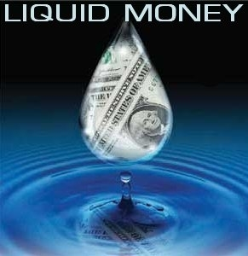
More Balancing: Profits and Liquidity
  Bankers pursue two other conflicting goals, Profits and Liquidity.
  The bank needs to lend money in order to make profits. But it also needs to have enough cash on hand to conduct daily business.
  If you arrived at your bank to make a withdrawal and they had no money what would you do?

Slide 23

The Banking System, cont’d.
  To trade off between risk and profit and profit and liquidity a bank divides its assets into four parts:
    Reserves
    Liquid assets
    Securities
    Loans

Slide 24
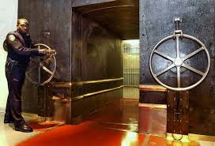
Reserves
  A bank’s reserves consist of currency in the bank’s vaults plus the balance on its reserve account at a Federal Reserve Bank.
  The Fed requires the banks and other financial institutions to hold a minimum percentage of deposits as reserves, called the required reserve ratio.
  Banks’ desired reserves might exceed the required reserves, especially when the cost of borrowing reserves is high.

Slide 25
How Banks Create Money

Slide 26

Liquid Assets
  Banks’ liquid assets are short-term Treasury bills and overnight loans to other banks.
  When banks have excess reserves, they can lend them to other banks that are short of reserves in an interbank loans market.
  The interbank loans market is called federal funds market and the interest rate on interbank loans is the federal funds rate.
  The Fed’s policy actions target the federal funds rate.

Slide 27
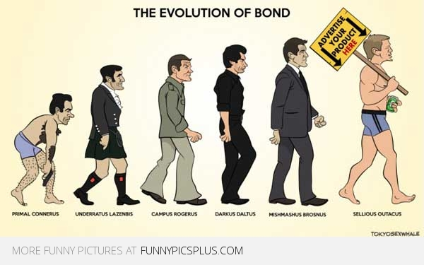
Securities and Loans
Securities held by banks are bonds issued by the U.S. government and by other organizations
  A bank earns a moderate interest rate on securities, but it can sell them quickly if it needs cash so they are quite liquid.

Slide 28

Securities and Loans, cont’d.
Loans are the funds that banks provide to businesses and individuals and include outstanding credit card balances
  Loans earn the bank a high interest rate, but they are risky and cannot be called in before the agreed date.

Slide 29
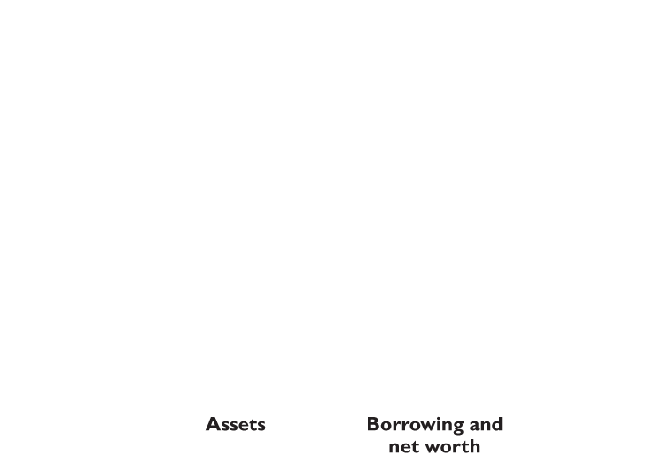
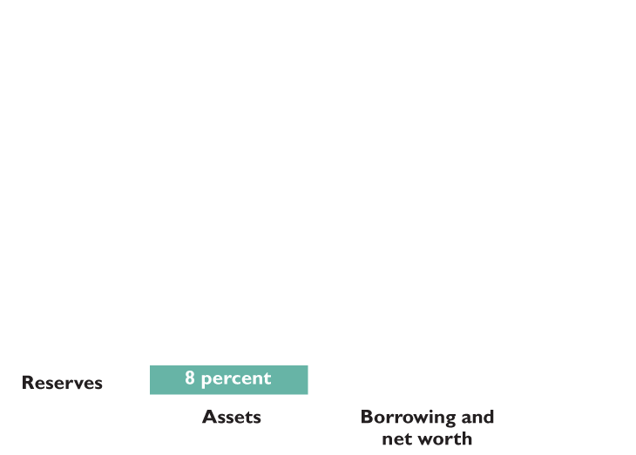
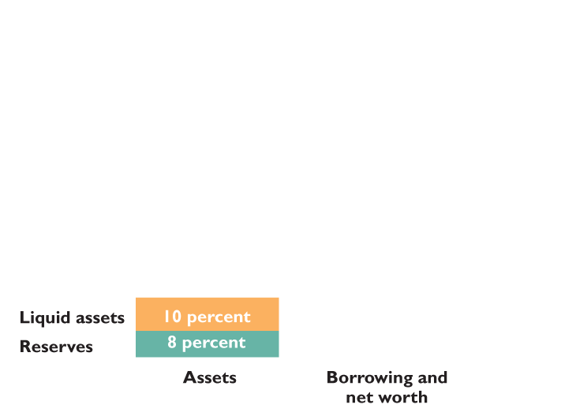
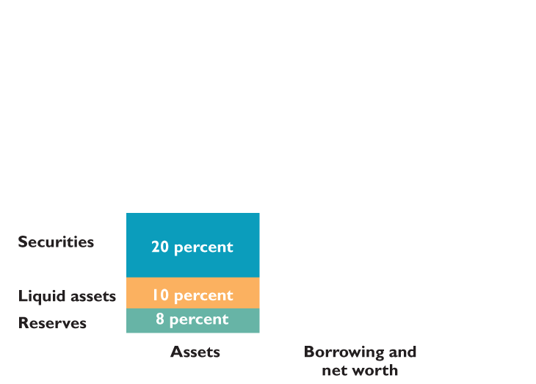
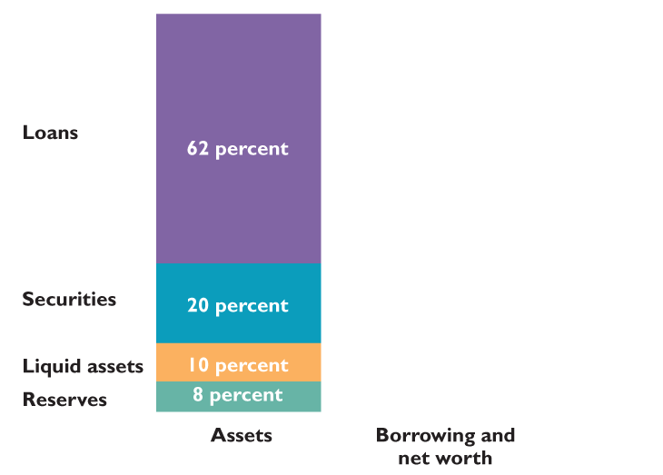
THE BANKING SYSTEM
  The figure shows that in 2009, commercial banks held :
  8 percent of total assets as reserves.
  10 percent as liquid assets.
  20 percent as securities.
  62 percent as loans.

Slide 30
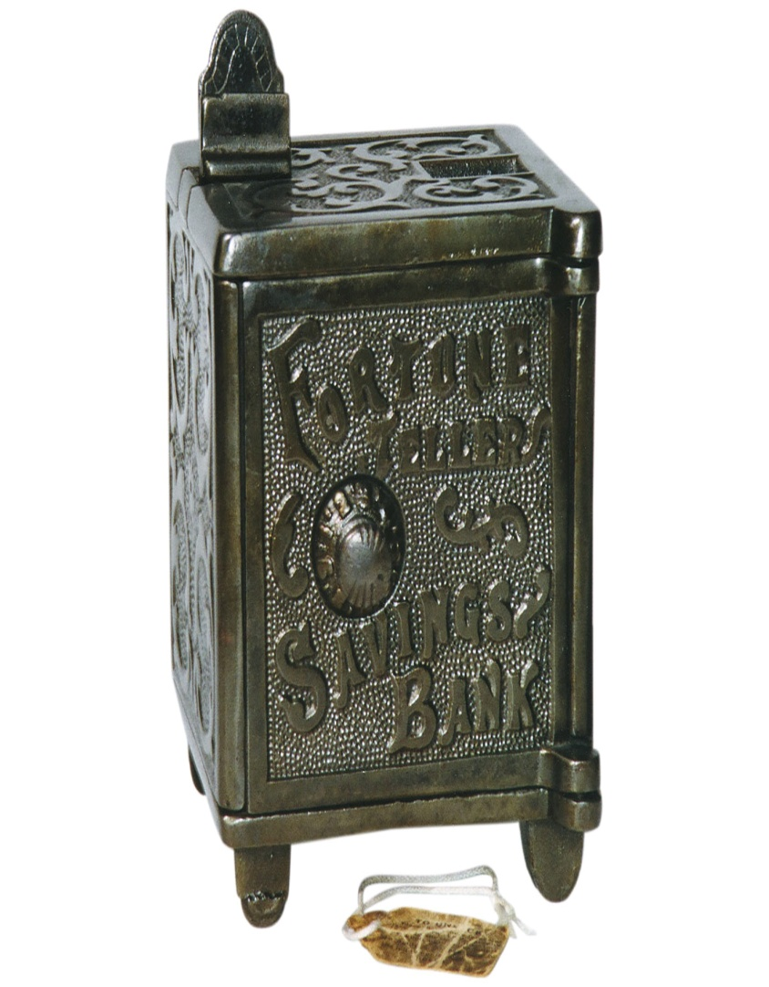
Thrift Institutions
  A savings and loan association (S&L) is a financial institution that accepts checkable deposits and savings deposits and that makes personal, commercial, and home-purchase loans.
  A savings bank is a financial institution that accepts savings deposits and makes mostly consumer and home-purchase loans.

Slide 31
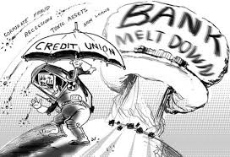
Thrift Institutions, Cont’d.
  A credit union is a financial institution owned by a social or economic group, such as a firm’s employees, that accepts savings deposits and makes mostly consumer loans.
  ****Like commercial banks, thrift institutions hold reserves and must meet minimum reserve ratios set by the Fed.

Slide 32
FORMATION OF A
COMMERCIAL BANK
LIABILITIES AND
NET WORTH
ASSETS
TRANSACTION 1
Creating a bank
$250,000 Cash
for
Capital Stock

Slide 33
FORMATION OF A
COMMERCIAL BANK
LIABILITIES AND
NET WORTH
ASSETS
Cash $250,000
Capital Stock $250,000
Deposit Added to Vault Cash

Slide 34
FORMATION OF A
COMMERCIAL BANK
LIABILITIES AND
NET WORTH
ASSETS
Cash $250,000
Capital Stock $250,000
TRANSACTION 2
Acquiring Property and
Equipment
$240,000 Cash

Slide 35
FORMATION OF A
COMMERCIAL BANK
LIABILITIES AND
NET WORTH
ASSETS
Cash $ 10,000
Property 240,000
Capital Stock $250,000
TRANSACTION 3
Accepting
Deposits
$100,000 Cash

Slide 36
FORMATION OF A
COMMERCIAL BANK
LIABILITIES AND
NET WORTH
ASSETS
Cash $110,000
Property 240,000
Checkable
Deposits $100,000
Capital Stock 250,000

Slide 37
FORMATION OF A
COMMERCIAL BANK
LIABILITIES AND
NET WORTH
ASSETS
NOTES:
Cash $110,000
Property 240,000
Checkable
Deposits $100,000
Capital Stock 250,000
Bank deposits are
subject to a reserve
requirement.
Commercial bank’s
required reserves
Reserve
ratio
=
Commercial bank’s
checkable-deposit
liabilities

Slide 38
FORMATION OF A
COMMERCIAL BANK
LIABILITIES AND
NET WORTH
ASSETS
Cash $110,000
Property 240,000
Checkable
Deposits $100,000
Capital Stock 250,000
Three Important Issues...
1 - Excess Reserves = Actual Reserves - Required Reserves
(assume 20% reserve requirement)
$110,000 - 20,000 = $90,000
2 – Control of Lending Ability
3 - Asset or Liability to Which Bank?

Slide 39
FORMATION OF A
COMMERCIAL BANK
LIABILITIES AND
NET WORTH
ASSETS
Cash $ 0
Reserves 110,000
Property 240,000
Checkable
Deposits $100,000
Capital Stock 250,000

Slide 40
FORMATION OF A
COMMERCIAL BANK
LIABILITIES AND
NET WORTH
ASSETS
Cash $ 0
Reserves 110,000
Property 240,000
Checkable
Deposits $100,000
Capital Stock 250,000
TRANSACTION 5
A check is drawn against the bank
$50,000

Slide 41
FORMATION OF A
COMMERCIAL BANK
LIABILITIES AND
NET WORTH
ASSETS
Cash $ 0
Reserves 60,000
Property 240,000
Checkable
Deposits $ 50,000
Capital Stock 250,000

Slide 42
FORMATION OF A
COMMERCIAL BANK
LIABILITIES AND
NET WORTH
ASSETS
NOTES:
Cash $ 0
Reserves 60,000
Property 240,000
Checkable
Deposits $ 50,000
Capital Stock 250,000
Banks create money
by lending excess
reserves and destroy
it by loan repayment.
Purchasing bonds
from the public also
creates money.

Slide 43
FORMATION OF A
COMMERCIAL BANK
LIABILITIES AND
NET WORTH
ASSETS
Reserves $ 60,000
Loans 50,000
Property 240,000
Checkable
Deposits $100,000
Capital Stock 250,000
Making the loan
created money!

Slide 44
FORMATION OF A
COMMERCIAL BANK
LIABILITIES AND
NET WORTH
ASSETS
Reserves $ 10,000
Loans 50,000
Property 240,000
Checkable
Deposits $ 50,000
Capital Stock 250,000
After a check for the $50,000
is drawn against the bank

Slide 45
FORMATION OF A
COMMERCIAL BANK
LIABILITIES AND
NET WORTH
ASSETS
Reserves $ 10,000
Loans 50,000
Property 240,000
Checkable
Deposits $ 50,000
Capital Stock 250,000
TRANSACTION 7
Repaying a loan with cash
$50,000

Slide 46
FORMATION OF A
COMMERCIAL BANK
LIABILITIES AND
NET WORTH
ASSETS
Reserves $ 10,000
Loans 0
Property 240,000
Checkable
Deposits $ 0
Capital Stock 250,000
$50,000 in money supply
is destroyed!

Slide 47
FORMATION OF A
COMMERCIAL BANK
LIABILITIES AND
NET WORTH
ASSETS
Reserves $ 60,000
Securities 50,000
Property 240,000
Checkable
Deposits $100,000
Capital Stock 250,000
Bankers pursue two conflicting goals:
Profits and Liquidity
Use of Federal Funds Market
Federal Funds Rate

Slide 48
MULTIPLE DEPOSIT EXPANSION PROCESS
Amount bank
can lend - New
money created
Acquired reserves
and deposits
Required
reserves
Excess
reserves
Bank
A
B
C
D
E
F
G
H
I
J
K
L
M
N
Other banks
$100.00
80.00
64.00
51.20
40.96
32.77
26.21
20.97
16.78
13.42
10.74
8.59
6.87
5.50
21.99
$20.00
16.00
12.80
10.24
8.19
6.55
5.24
4.20
3.36
2.68
2.15
1.72
1.37
1.10
4.40
$80.00
64.00
51.20
40.96
32.77
26.21
20.97
16.78
13.42
10.74
8.59
6.87
5.50
4.40
17.59
$80.00
64.00
51.20
40.96
32.77
26.21
20.97
16.78
13.42
10.74
8.59
6.87
5.50
4.40
17.59
Total amount of money created by the banking system
$400.00

Slide 49
MULTIPLE DEPOSIT EXPANSION PROCESS
Amount bank
can lend - New
money created
Acquired reserves
and deposits
Required
reserves
Excess
reserves
Bank
A
B
C
D
E
F
G
H
I
J
K
L
M
N
Other banks
$100.00
80.00
64.00
51.20
40.96
32.77
26.21
20.97
16.78
13.42
10.74
8.59
6.87
5.50
21.99
$20.00
16.00
12.80
10.24
8.19
6.55
5.24
4.20
3.36
2.68
2.15
1.72
1.37
1.10
4.40
$80.00
64.00
51.20
40.96
32.77
26.21
20.97
16.78
13.42
10.74
8.59
6.87
5.50
4.40
17.59
$80.00
64.00
51.20
40.96
32.77
26.21
20.97
16.78
13.42
10.74
8.59
6.87
5.50
4.40
17.59
Money
destruction works
in exactly the same
multiple way!
Total amount of money created by the banking system
$400.00

Slide 50
THE MONETARY MULTIPLIER
=
1
Monetary
Multiplier
Required reserve ratio
Maximum
checkable-
deposit
creation
=
x
Excess
reserves
Monetary
Multiplier

Slide 51
OUTCOME OF MONEY EXPANSION
$100
New reserves
$20
Required
reserves
$80
Excess
reserves
Leakages exist...
Currency Drains
Excess Reserves
$400
Bank system lending
$100
Initial
Deposit
Money Created

Slide 52
How much money is created in the economy by the excess reserves??
Deposit Amount = 1000. Reserve requirement = 10%
What is the money multiplier?
1/reserve ratio
1/.10 = 10
Multiplier x Excess Reserves = Money Created
10 x $900 = $9,000

Slide 53
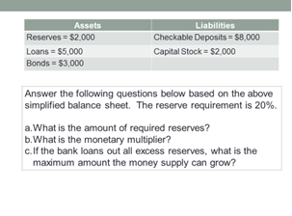

Slide 54
